Slide 1
Red-Black Tree

Slide 2
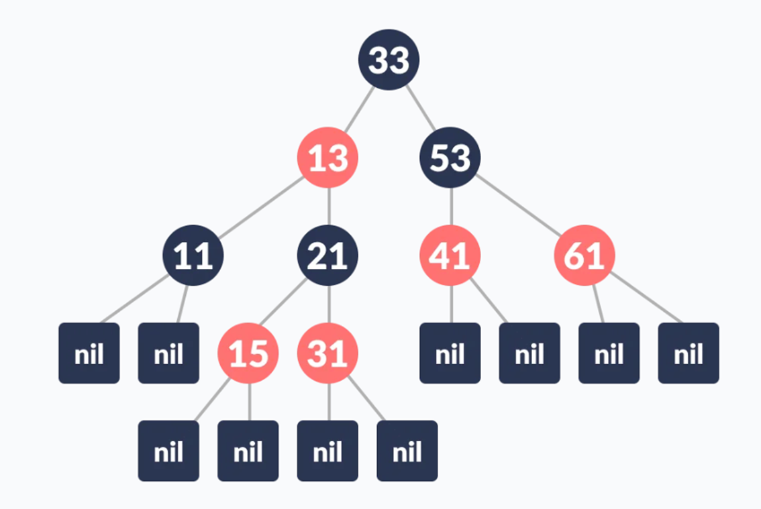
Red-Black tree is a self-balancing binary search tree with an extra bit for the color of the node.
Red/Black Property: Every node is colored, either red or black.
Root Property: The root is black.
Leaf Property: Every leaf (NIL) is black.
Red Property: If a red node has children, then the children are always black.
Depth Property: For each node, any simple path from this node to any of its descendant leaf has the same black-depth (the number of black nodes).

Slide 3
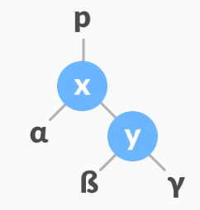
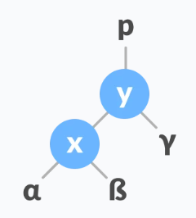
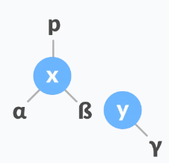
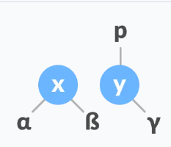
Left Rotate
Initial tree
1. If y has a left subtree, assign x as the parent of the left subtree of y
2. If the parent of x is NULL, make y as the root of the tree.
3. Else if x is the left child of p, make y as the left child of p
4. Else assign y as the right child of p
5. Make y as the parent of x

Slide 4
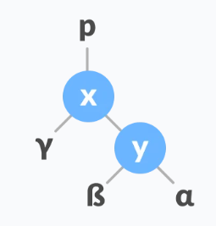
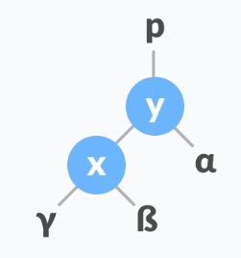
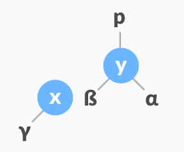
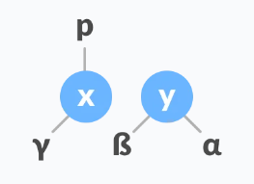
Right Rotate
Initial tree
1. If x has a right subtree, assign y as the parent of the right subtree of x
2. If the parent of y is NULL, make x as the root of the tree.
3. Else if y is the right child of its parent p, make x as the right child of p.
4. Else assign x as the left child of p
5. Make x as the parent of y

Slide 5
Inserting an element into a Red-Black Tree
While inserting a new node, the new node is always inserted as a RED node. After insertion of a new node, if the tree is violating the properties of the red-black tree then, we do the following operations.
Recolor
Rotation

Slide 6
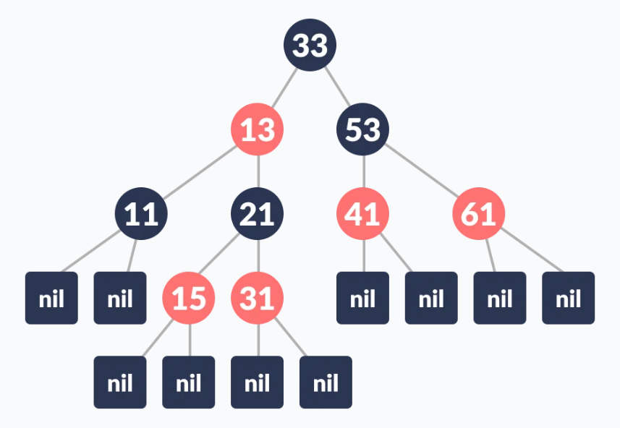
Algorithm to insert a node
Let y be the leaf (i.e., NIL) and x be the root of the tree.
Check if the tree is empty (i.e., whether x is NIL). If yes, insert newNode as a root node and color it black.
Else, repeat steps following steps until leaf (NIL) is reached.
Compare newKey with rootKey.
If newKey is greater than rootKey, traverse through the right subtree.
Else traverse through the left subtree.
Assign the parent of the leaf as a parent of newNode.
If leafKey is greater than newKey, make newNode as rightChild.
Else, make newNode as leftChild.
Assign NULL to the left and rightChild of newNode.
Assign RED color to newNode.
Call InsertFix-algorithm to maintain the property of red-black tree if violated.

Slide 7
References
[1] https://www.programiz.com/dsa/red-black-tree

